Slide 1
Testing and Measurement Needs Including Standardization
Edward Herbert PSMA

Slide 2
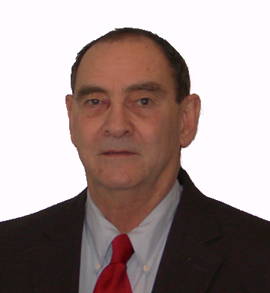
Biography: Edward Herbert
Ed earned a Bachelor of Engineering degree in Electrical Engineering from Yale University, Class of 1963.
He worked as a design engineer, a project engineer, an engineering supervisor, then as engineering manager until 1985. Since then, Ed had been independent, promoting patented technology for license.
Within PSMA, Ed is Co-Chairman of the Magnetics Committee and is on the Advisory Council. He was a member of the PSMA Board of Directors and was a Co-Chairman of the Energy Efficiency Committee.
Ed was champion of the core loss studies at Dartmouth and SMA.

Slide 3
PSMA Core Loss Studies
PSMA has sponsored several core loss studies.
Three projects were at Dartmouth, under the direction of Charles Sullivan.
Two projects were at SMA in Krakow, Poland, under the direction of Marcin Kacki
These projects mostly studied ferrites under square wave excitation.
The reports of these studies can be viewed on the PSMA website, https://www.psma.com/

Slide 4
Some conclusions from the Core Loss Studies
Preference for square wave excitation
“Herbert Curves” to present the optimum operating point of a core
One size does NOT fit all, particularly for larger cores
“Herbert Equation,” an equation that approximates core loss
SPICE models

Slide 5
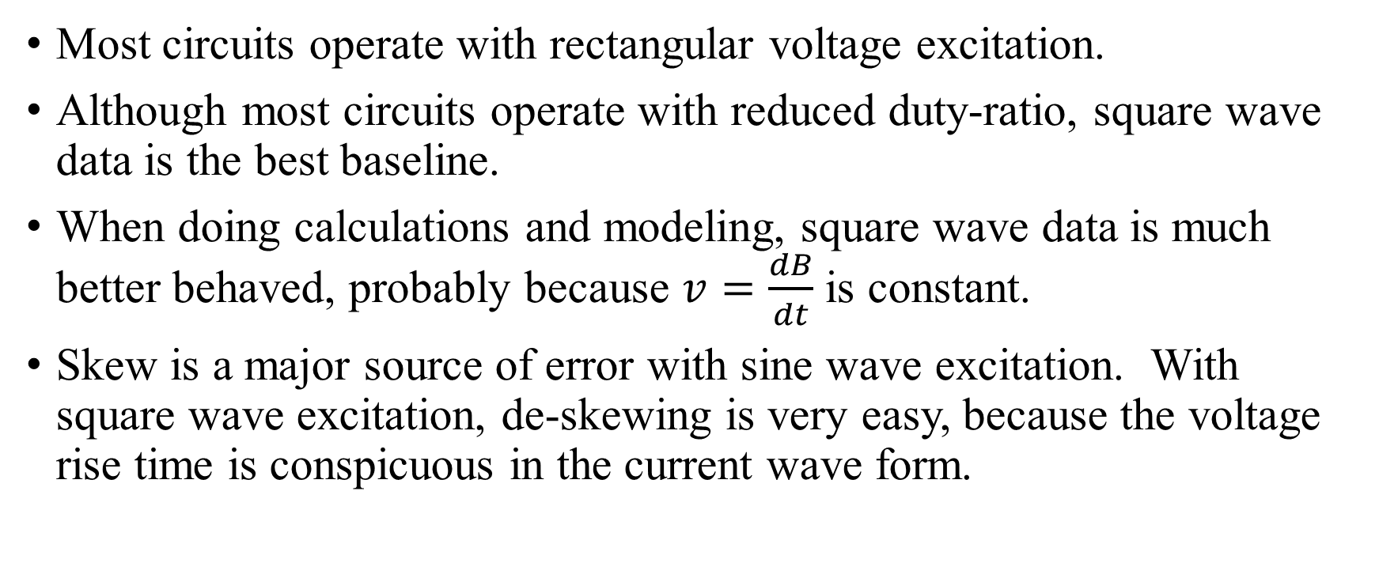
Preference for square wave excitation
Most circuits operate with rectangular voltage excitation.
Although most circuits operate with reduced duty-ratio, square wave data is the best baseline.
When doing calculations and modeling, square wave data is much better behaved, probably because $v=\frac{dB}{dt}$ is constant.
Skew is a major source of error with sine wave excitation. With square wave excitation, de-skewing is very easy, because the voltage rise time is conspicuous in the current wave form.

Slide 6
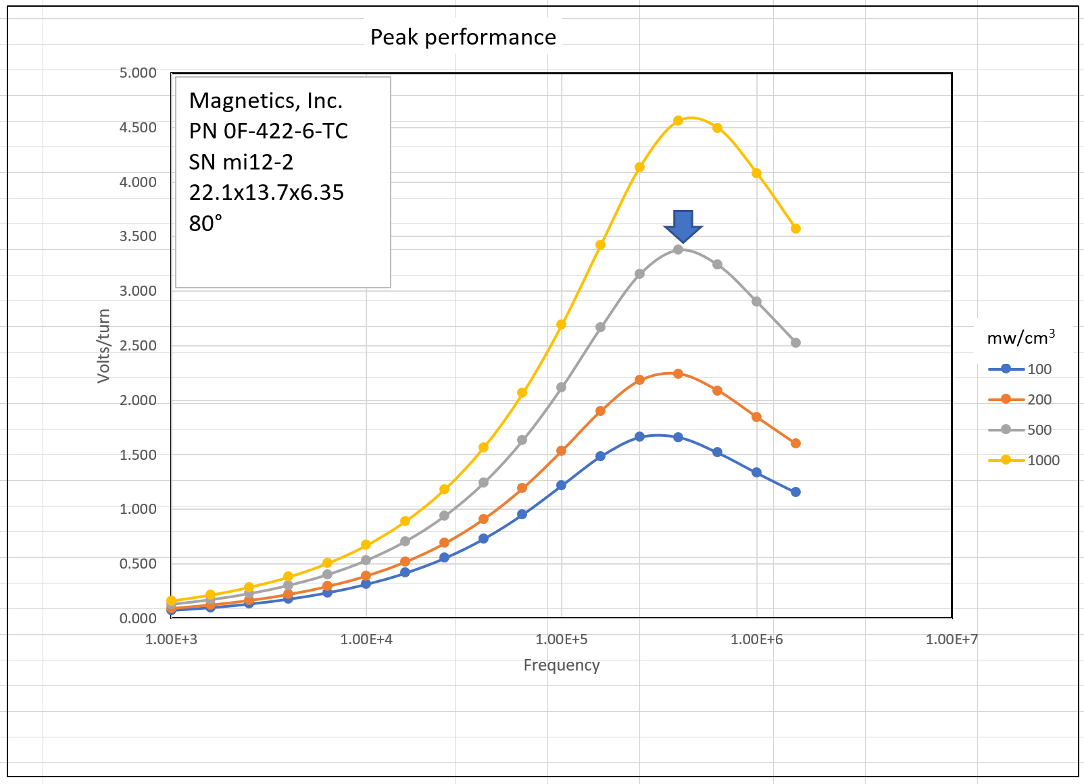
Herbert Curves
The familiar B*f curve most directly identifies the optimum operating point for a core.
For a specific core, with square-wave excitation, the familiar B*f curve can be scaled to show the volts per turn for a specific power density vs frequency.
The arrow shows the prime point, the frequency where the loss is lowest for 500 mw/cm³, and the voltage that the flux will sustain at that point, in volts/turn.
GaN and SiC make it more likely that magnetic components can be designed for their optimum operating point.

Slide 7
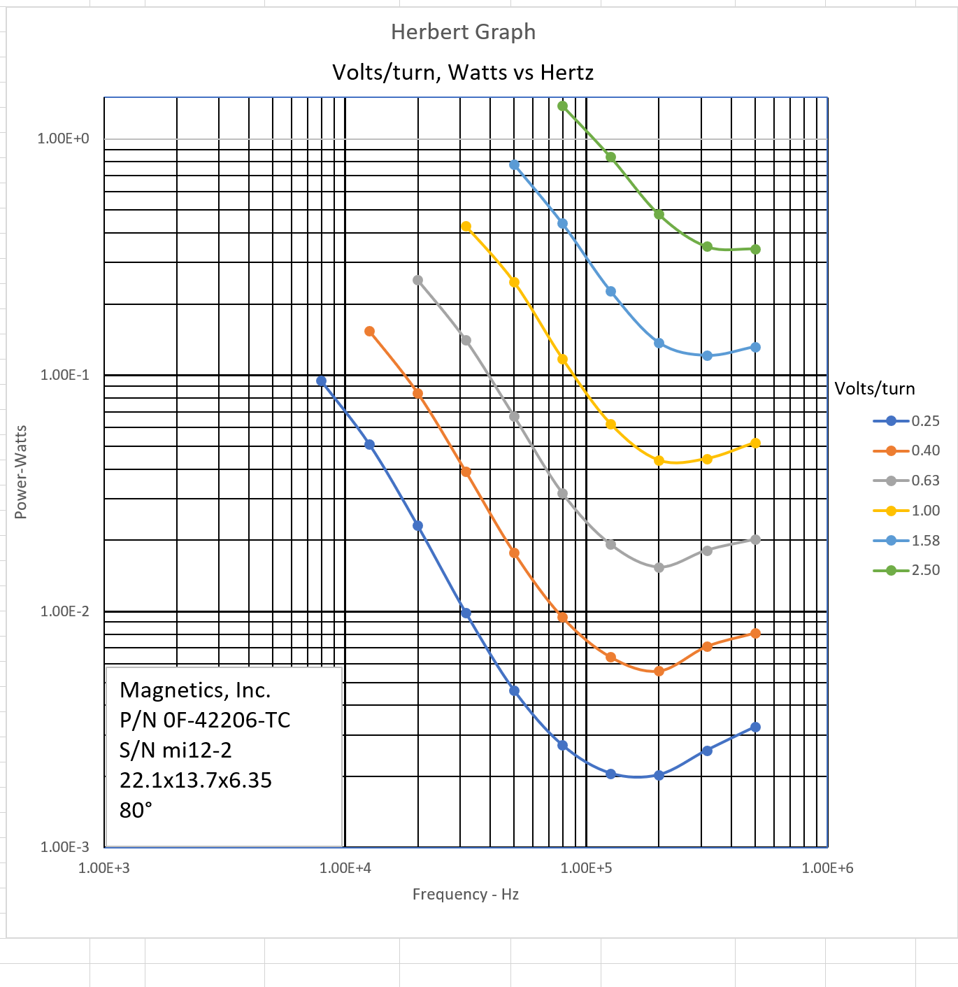
Herbert Curves
I recommend a graph with curves of constant excitation voltage, with frequency as the X-axis and core loss as the Y-axis.
To find the core loss at any excitation voltage and frequency, draw a vertical line from the frequency to the excitation voltage of interest, then draw a horizontal line to the Y-axis. Read the loss in Watts.

Slide 8
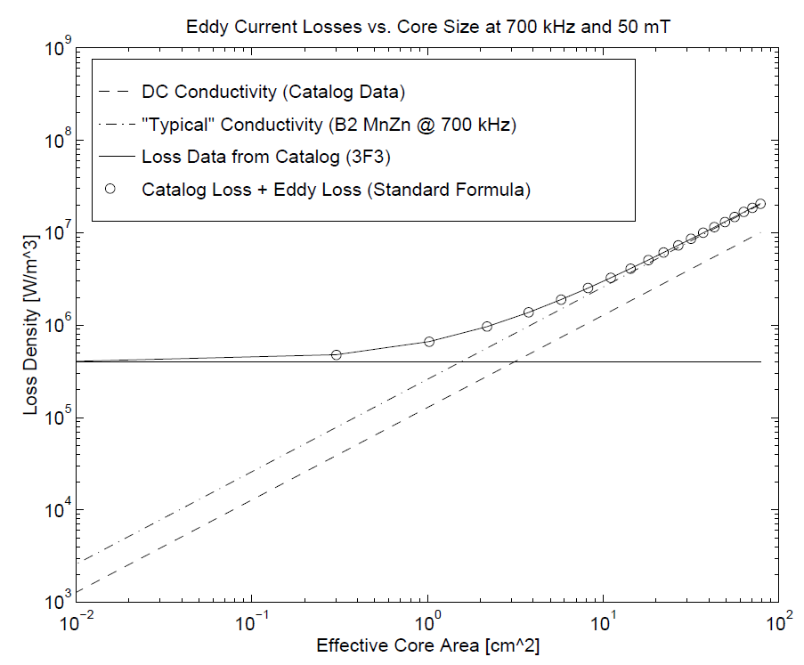
One size does NOT fit all, particularly for larger cores
It is known, but largely ignored, that different sized cores have different losses. This is not new. The graph on the right is copied from Glenn Skutt’s thesis, presented in 1996.
The optimum operating point for a core is very dependent on its size.
That does not mean that there must be a catalog sheet for every core, but a data sheet for every core should be available “on line” or on a USB stick.

Slide 9
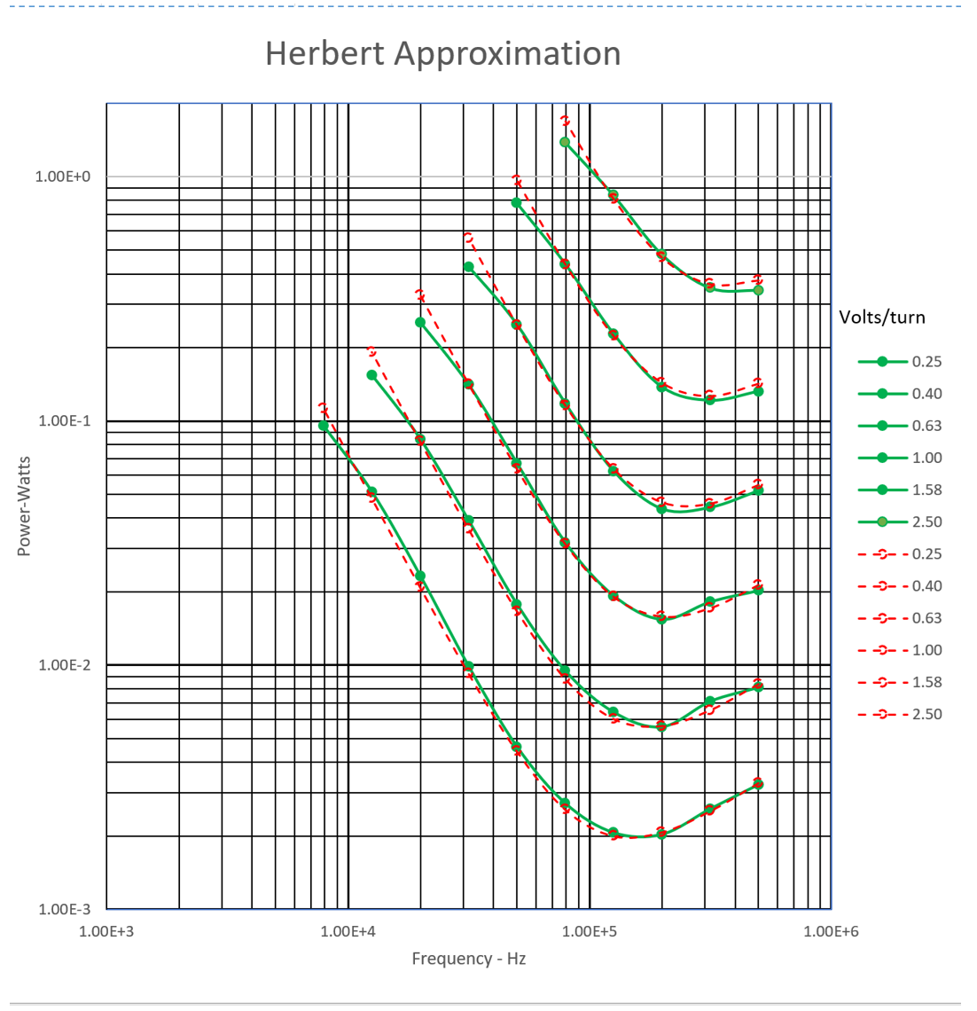
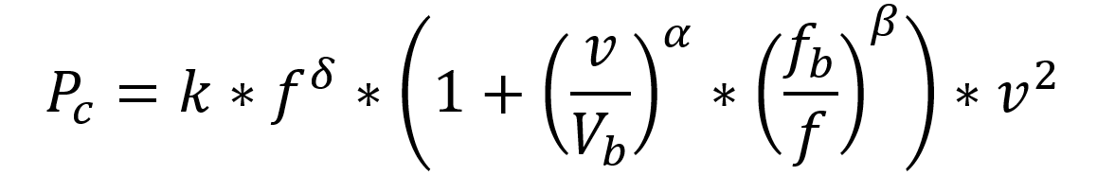
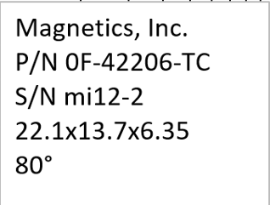
Herbert equation
Much effort has gone into finding an equation that will approximate the losses over the entire range of interest for excitation and frequency.
This equation seems to work fairly well. The green lines and dots are data, and the red dashed lines are the approximation.
k 4.200E-07
δ 6.500E-01
α 1.000E+00
β 2.500E+00
V_{b} 1.250E+00
F_{b} 9.615E+04

Slide 10
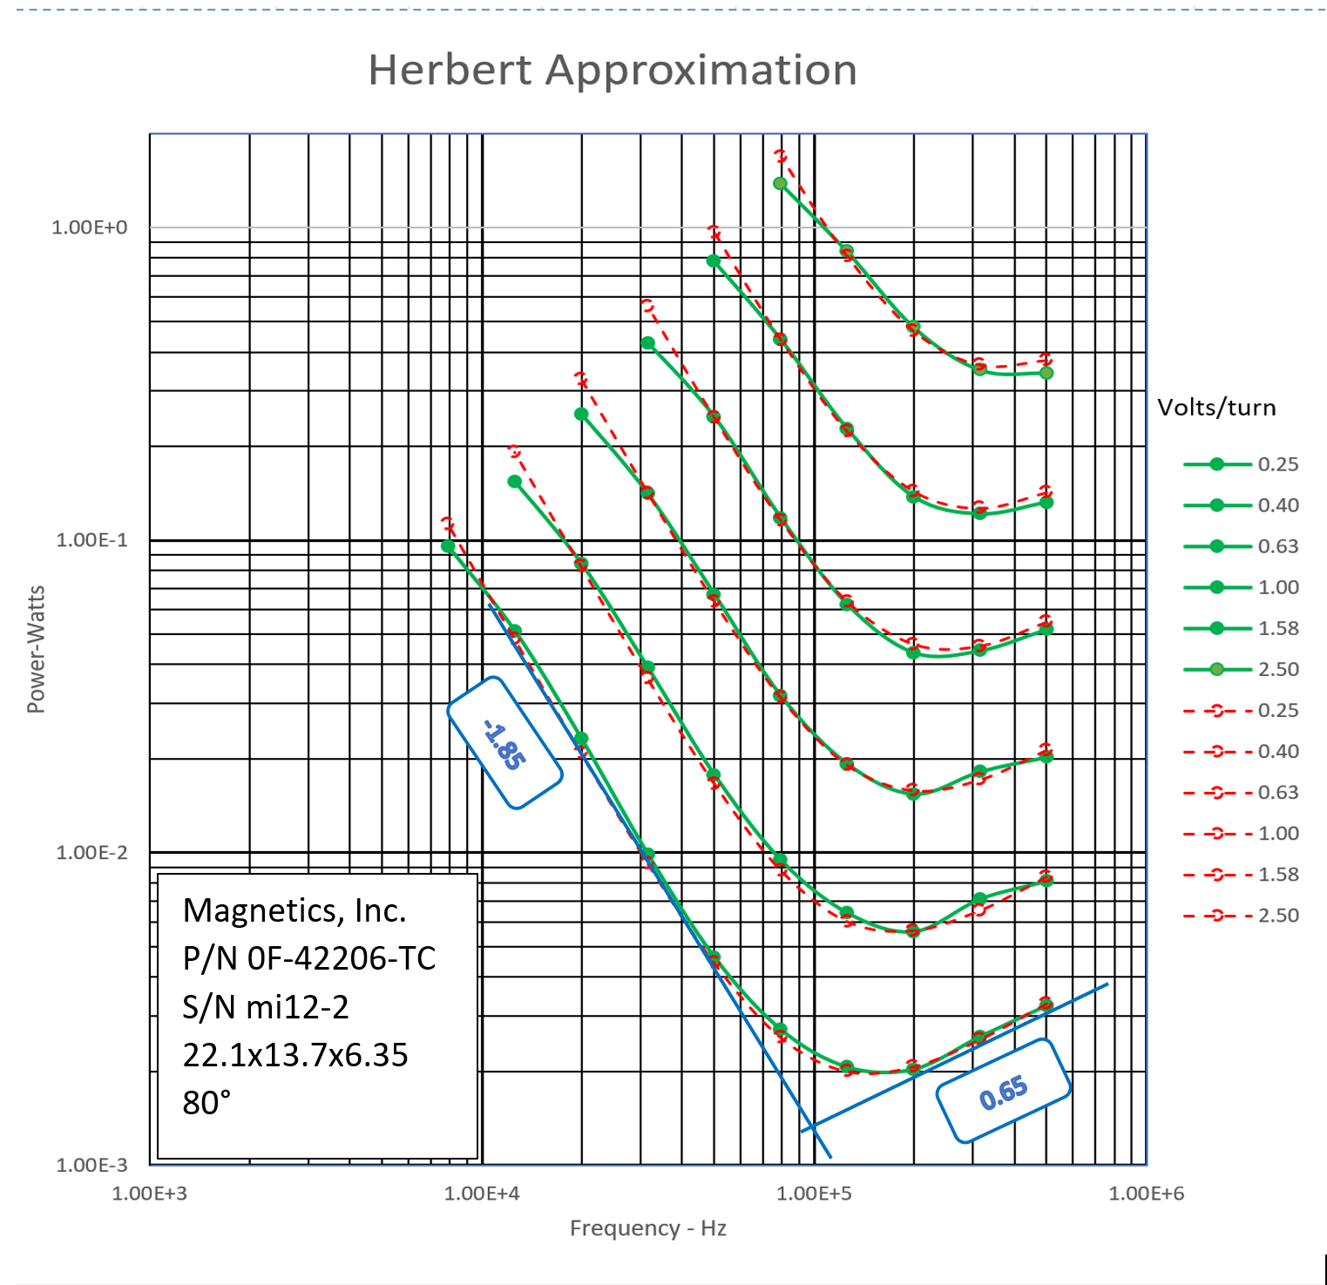
Herbert equation
For the F-42206-TC core, the constants are:
k 4.200E-07
δ 6.500E-01
α 1.000E+00
β 2.500E+00
V_{b} 1.250E+00
F_{b} 9.615E+04
The constant δ = 0.65 is the slope of the asymptote of the curve on the right-hand end in the example above.
The constant β = 2.5 is derived from the slope of the asymptote of the curve on the left by subtracting it from δ = 0.65. That is, 0.65 –(–1.85) = 2.5
The constant V_{b} is a baseline voltage.
The constant f_{b} is 96 kHz, and is approximately at the intercept of the asymptotes.

Slide 11
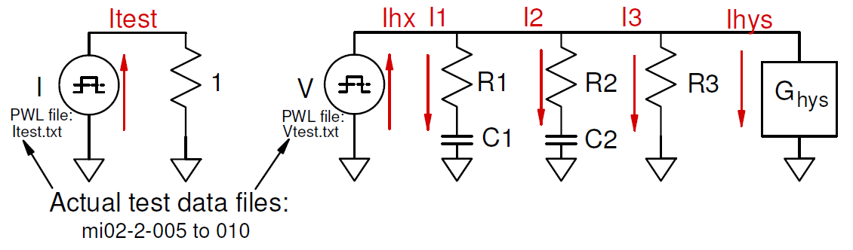
SPICE models
The premise of the SPICE model is that if you can excite the model with a wave form derived from actual test data as a PWL file, and if the resulting simulation current matches the actual test current also as a PWL file, they you have a reasonably good model.
Displaying the the simulation as hysteresis loops is particularly good for comparison.
We could not find any combination or Rs, Cs and Ls that would simulate the low frequency performance of the core. For that, we needed to model a hysteretic inductor, G_{hys}.

Slide 12
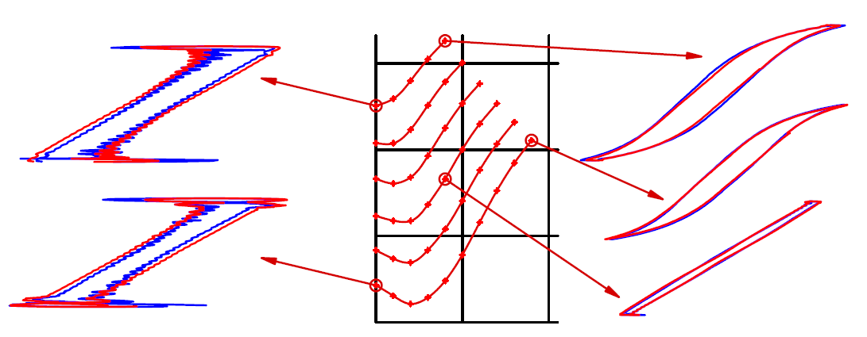
SPICE models
The fit is good over the entire range of data
The blue curves are the data from the PSMA-Dartmouth Core Loss Studies.
The red curves are the SPICE model results when applying the voltage from the data.
The scales vary widely in the different curves, but the aspect ratio is fixed.
It is the shape that is important.

Slide 13
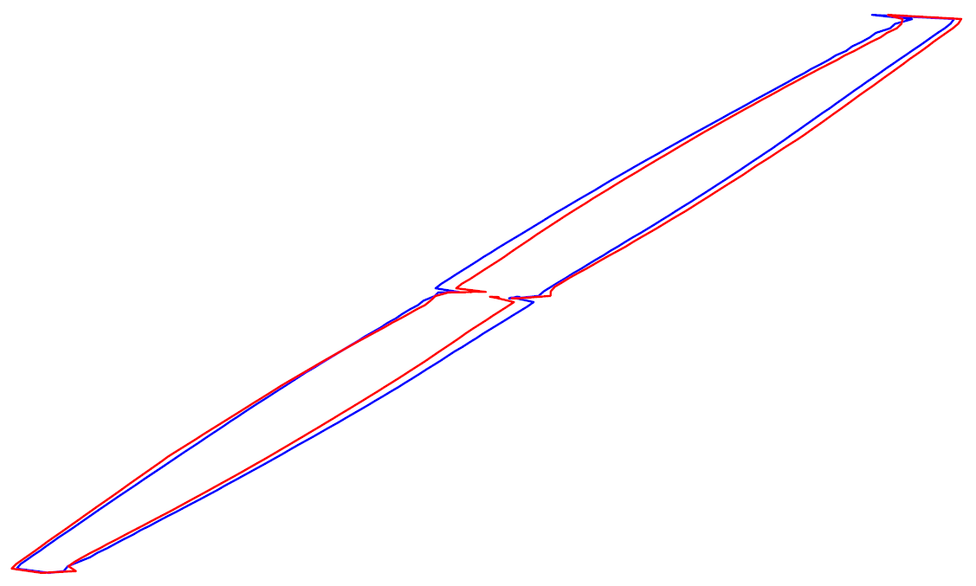
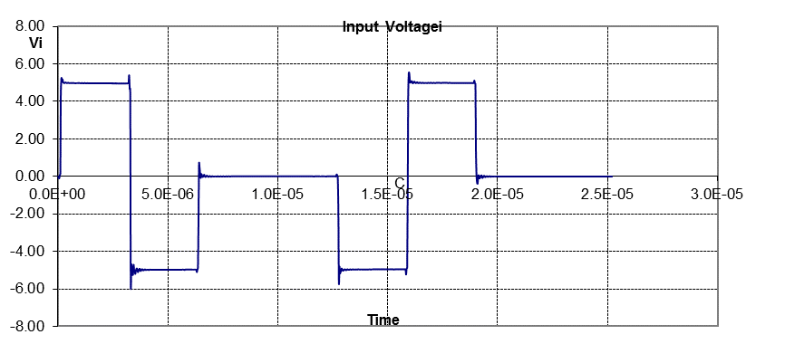
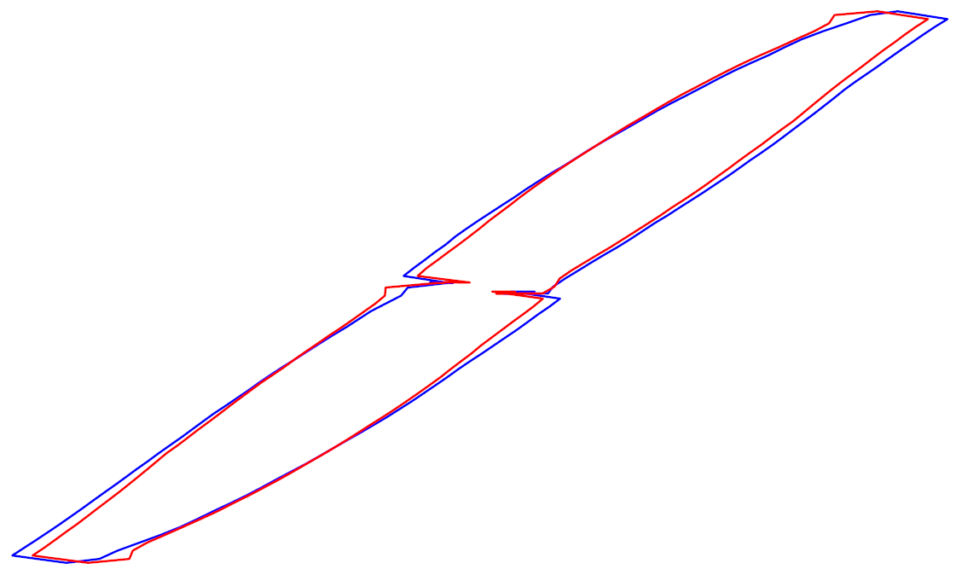
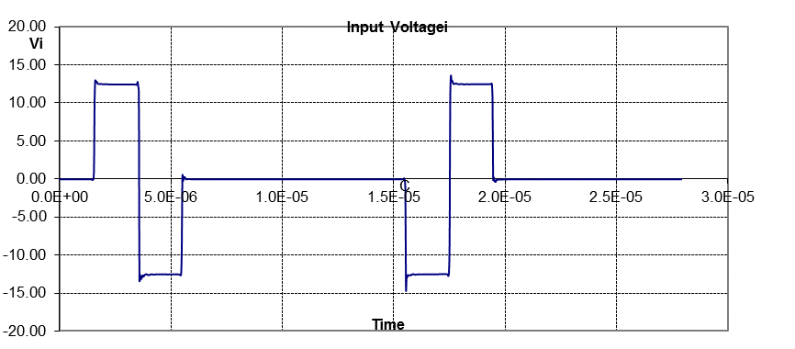
SPICE models
Other wave forms
The SPICE model fits the data fairly well for the
“Hippo” waveform.
Note the tuck in the hysteresis curve near zero.
mi12-2-132
mi12-2-150

Slide 14
Thank you
Questions are welcome

Slide 15
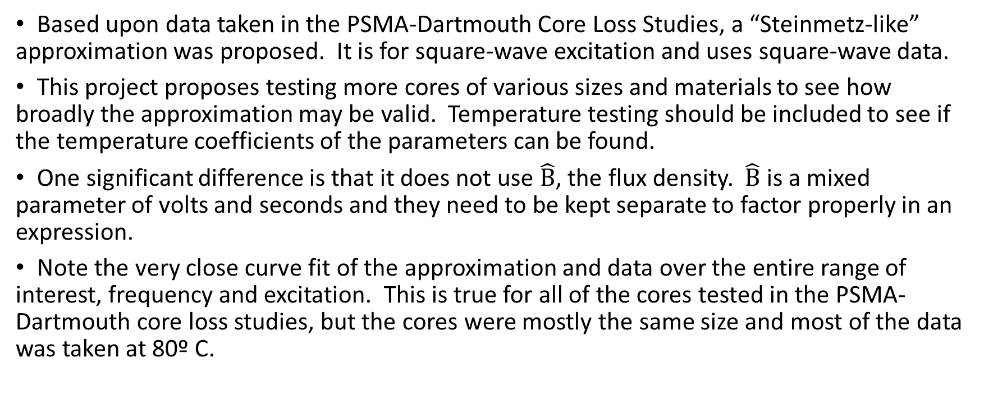
Steinmetz-like approximation for square-wave excitation.
Based upon data taken in the PSMA-Dartmouth Core Loss Studies, a “Steinmetz-like” approximation was proposed. It is for square-wave excitation and uses square-wave data.
This project proposes testing more cores of various sizes and materials to see how broadly the approximation may be valid. Temperature testing should be included to see if the temperature coefficients of the parameters can be found.
One significant difference is that it does not use $\hat{B}$, the flux density. $\hat{B}$ is a mixed parameter of volts and seconds and they need to be kept separate to factor properly in an expression.
Note the very close curve fit of the approximation and data over the entire range of interest, frequency and excitation. This is true for all of the cores tested in the PSMA-Dartmouth core loss studies, but the cores were mostly the same size and most of the data was taken at 80º C.

Slide 16
Steinmetz-like approximation for square-wave excitation -- Graphs
Following are graphs for the following cores from the PSMA-Dartmouth Core Loss Study: Rmi-005; Rcm01; Rcm02; Rmi11-1; Rmi01-4; Rmi01-2; Rfx003; Rmi02; Rmi11-1 and Rfx003.
The graphs displaty the actual data as heavier lines with dots, which are the data points. The approximation is shown as thinner red dashed lines.
The data is displayed both as a Herbert curve and as the more traditional Bm and f graph. The data is the same; it’s just connected differently.

Slide 17
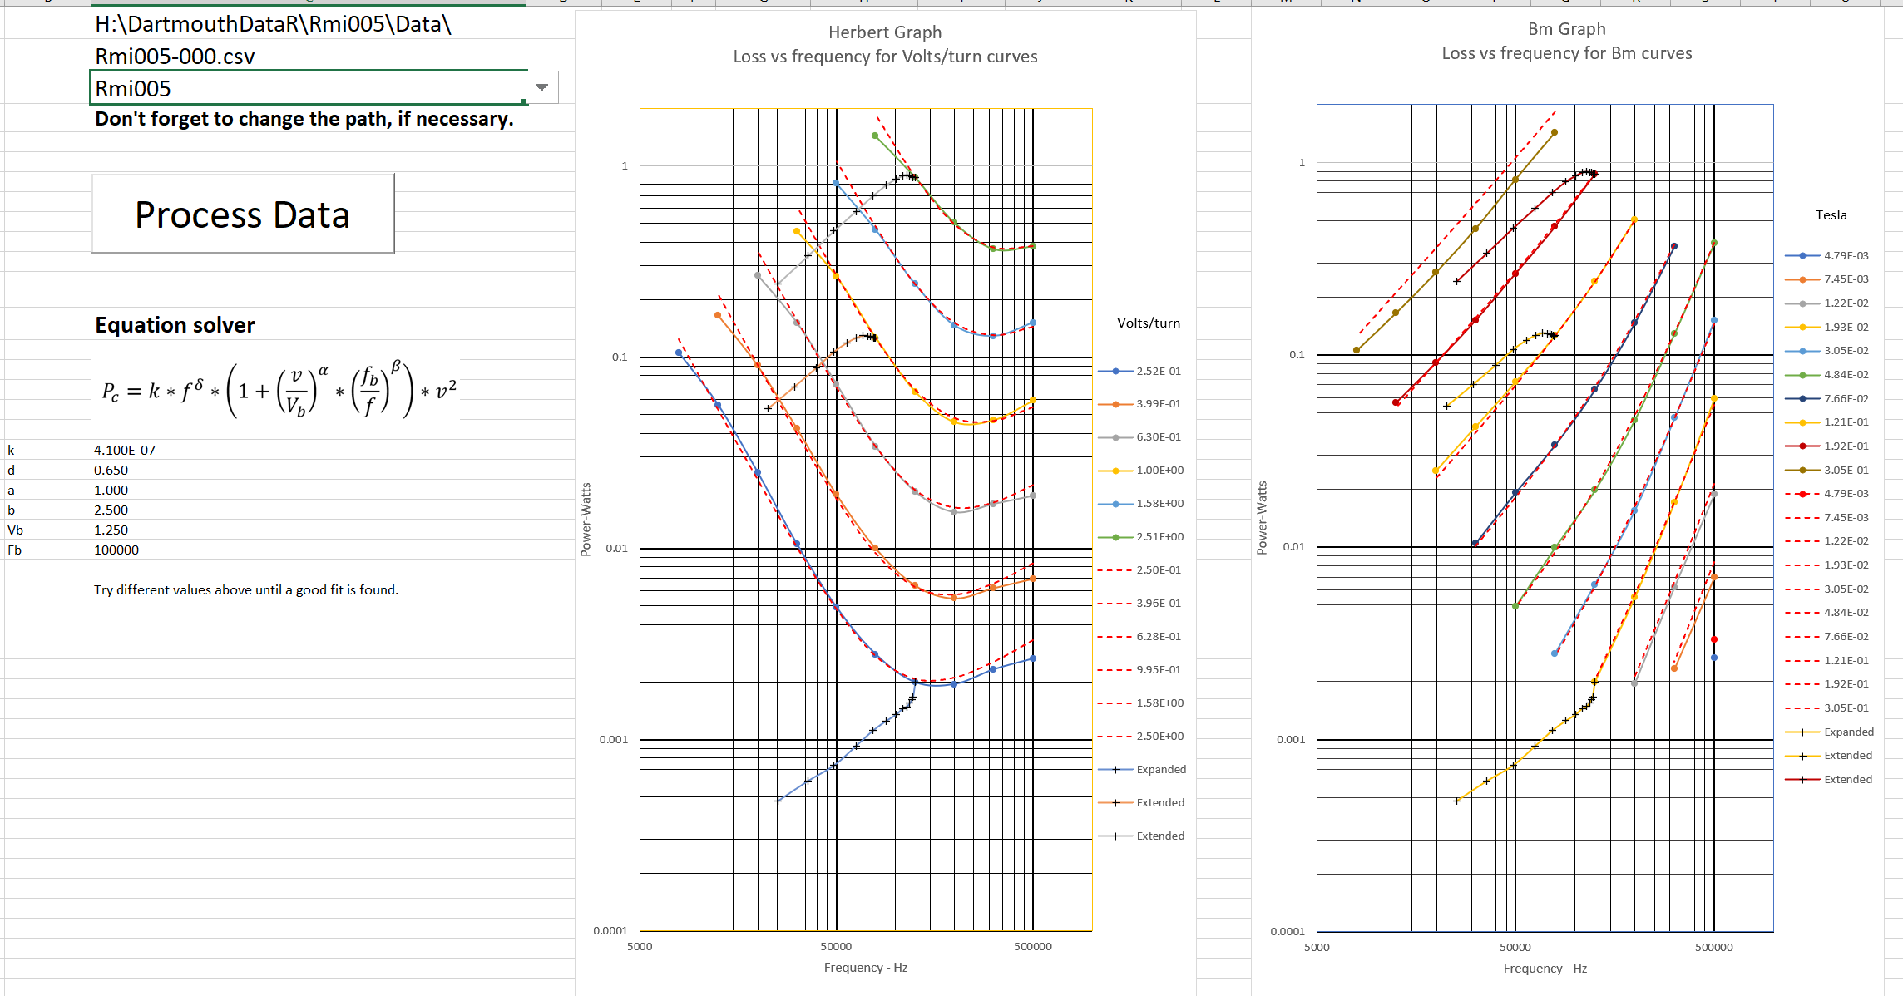

Slide 18
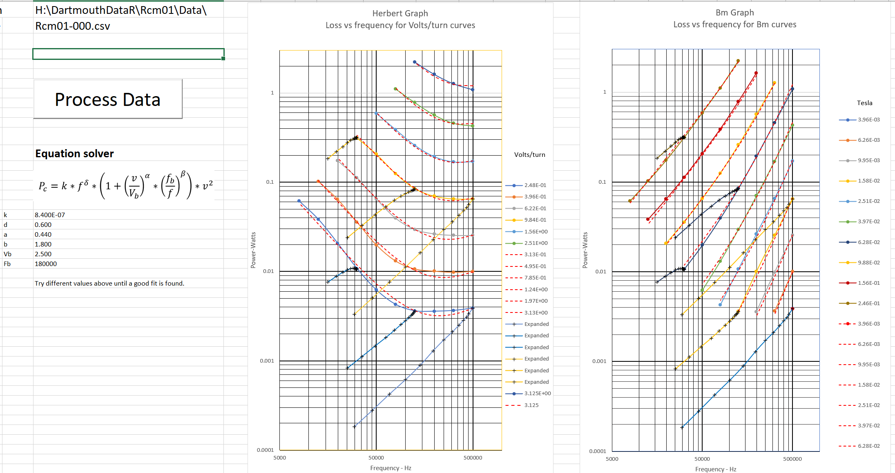

Slide 19
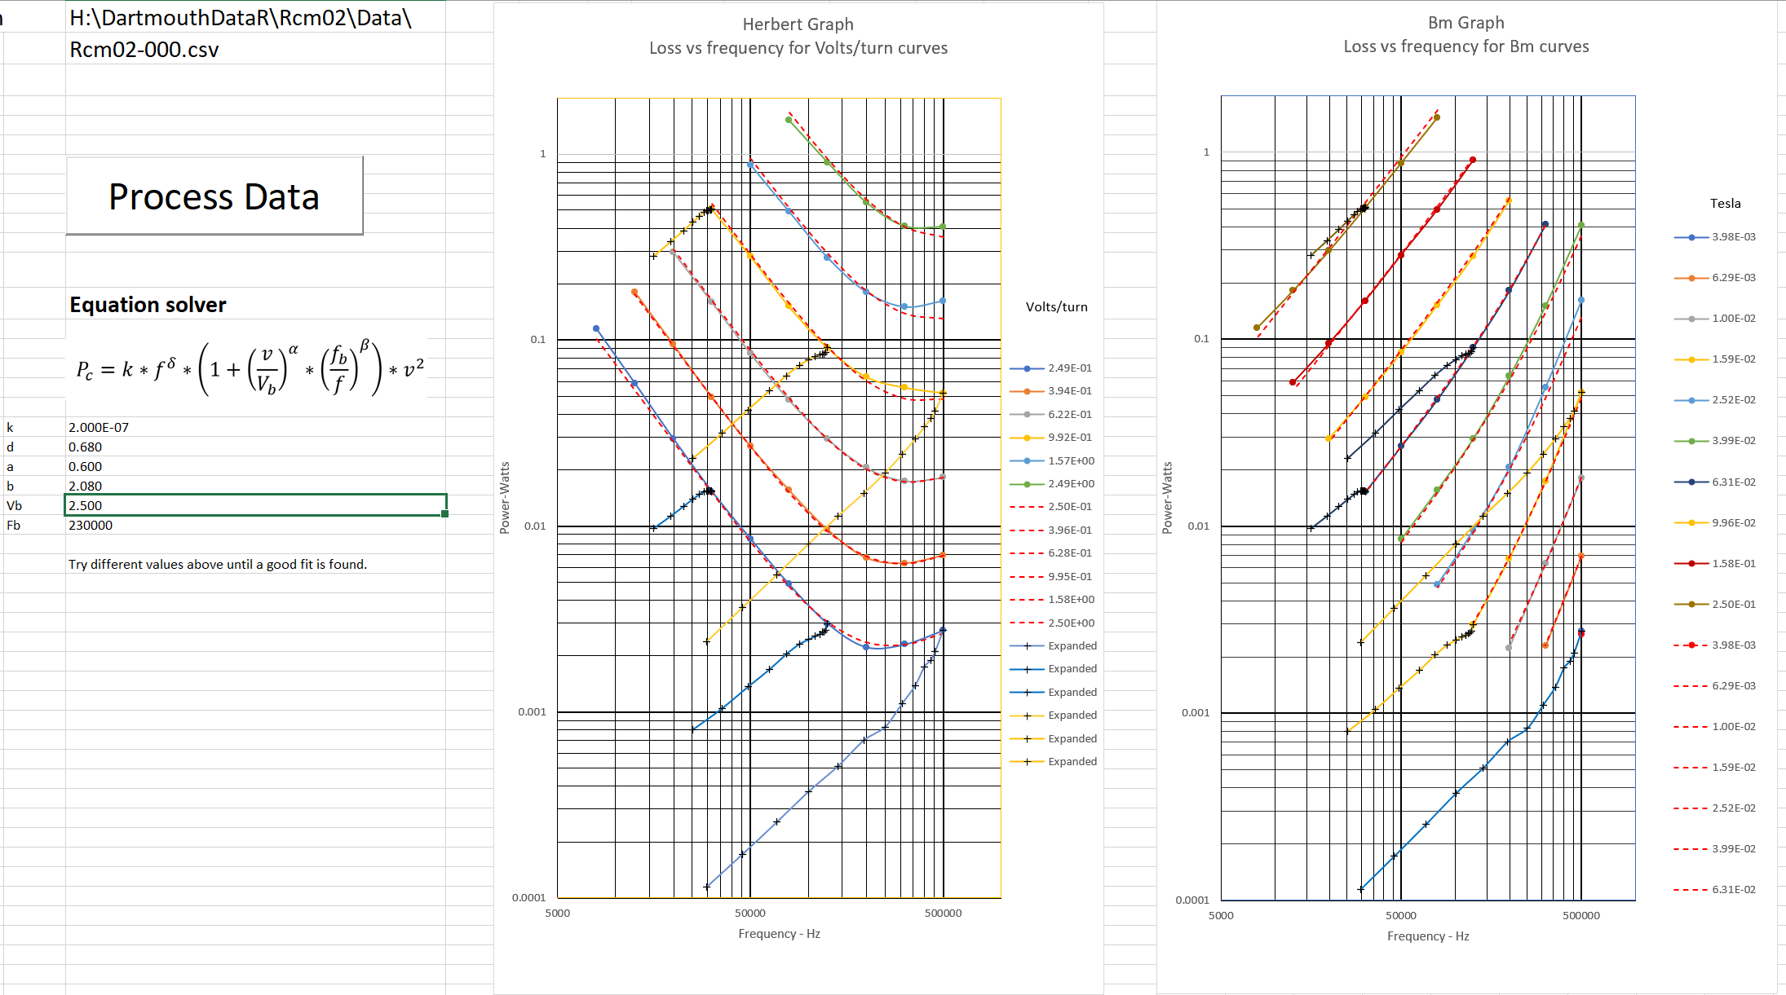

Slide 20
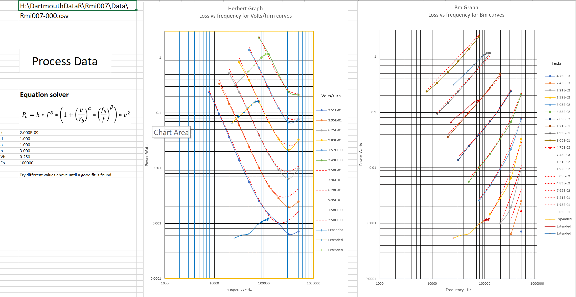

Slide 21
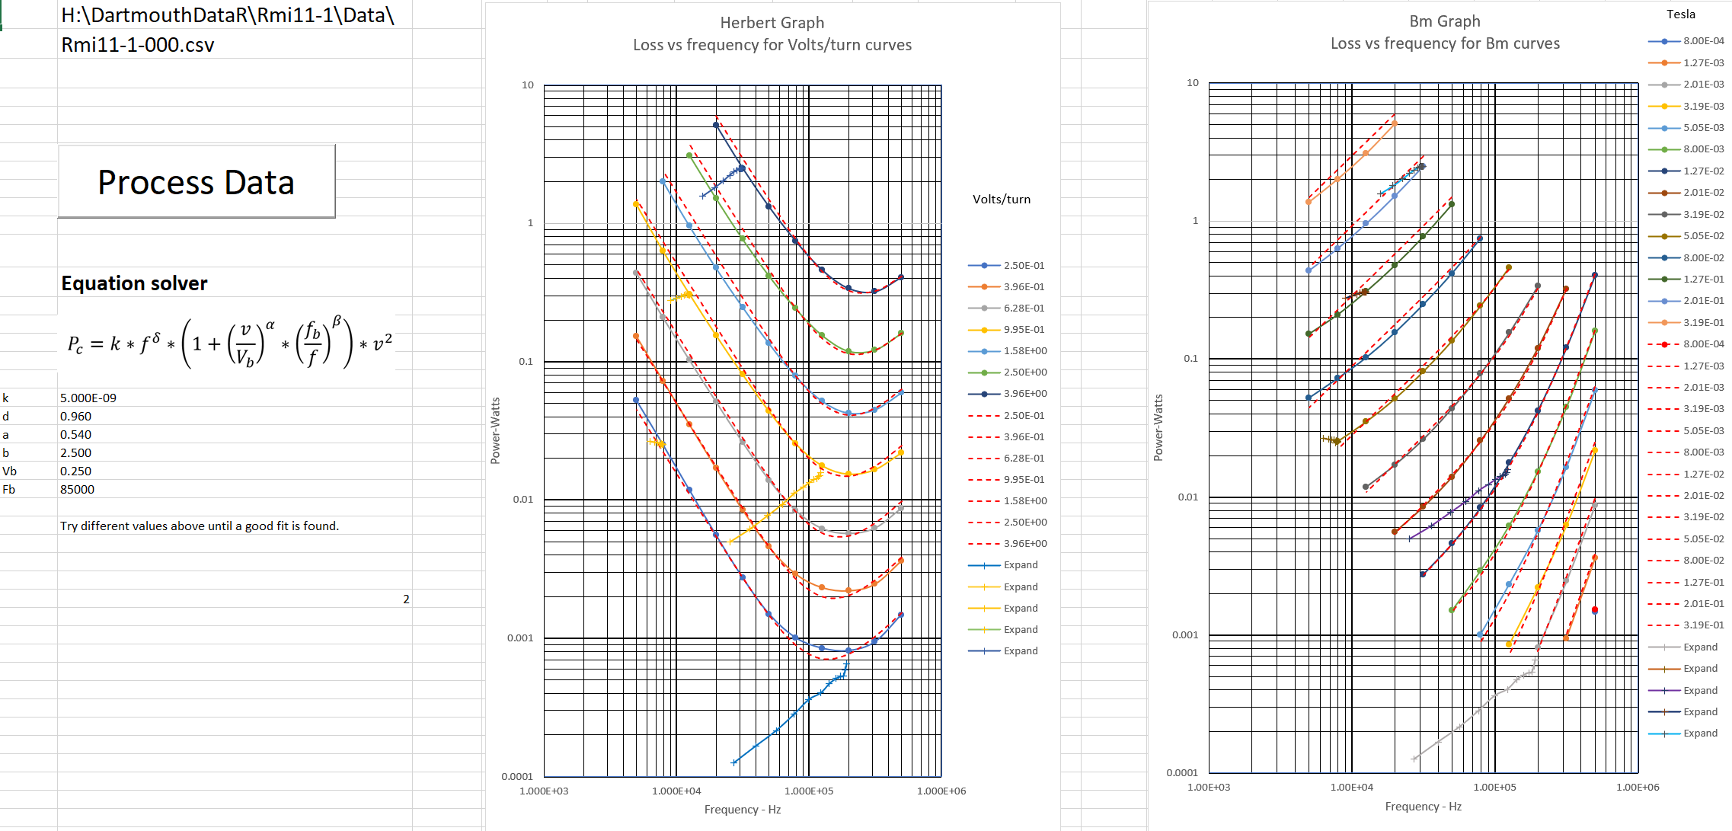

Slide 22
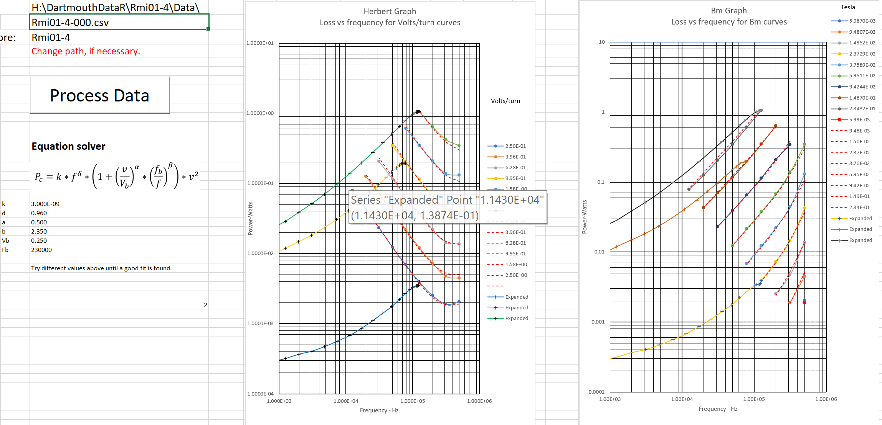

Slide 23
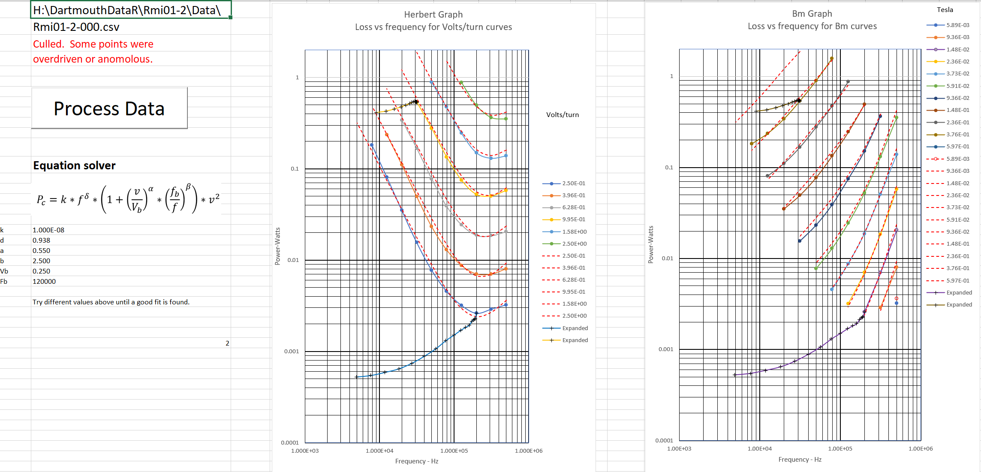

Slide 24
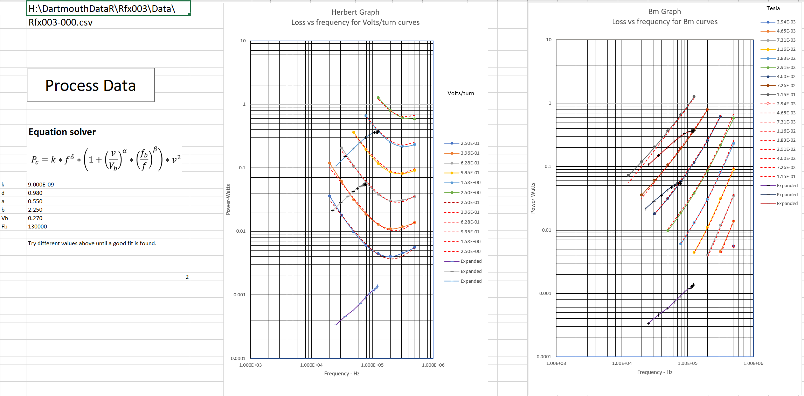

Slide 25
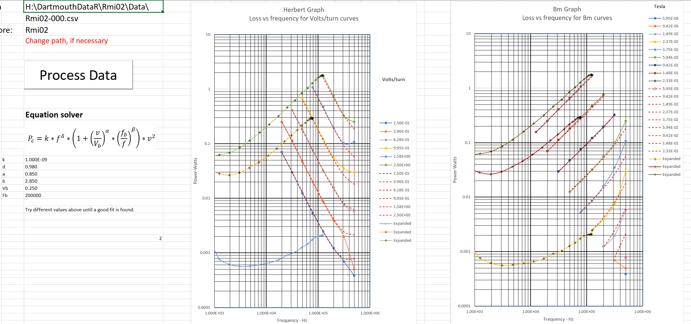

Slide 26
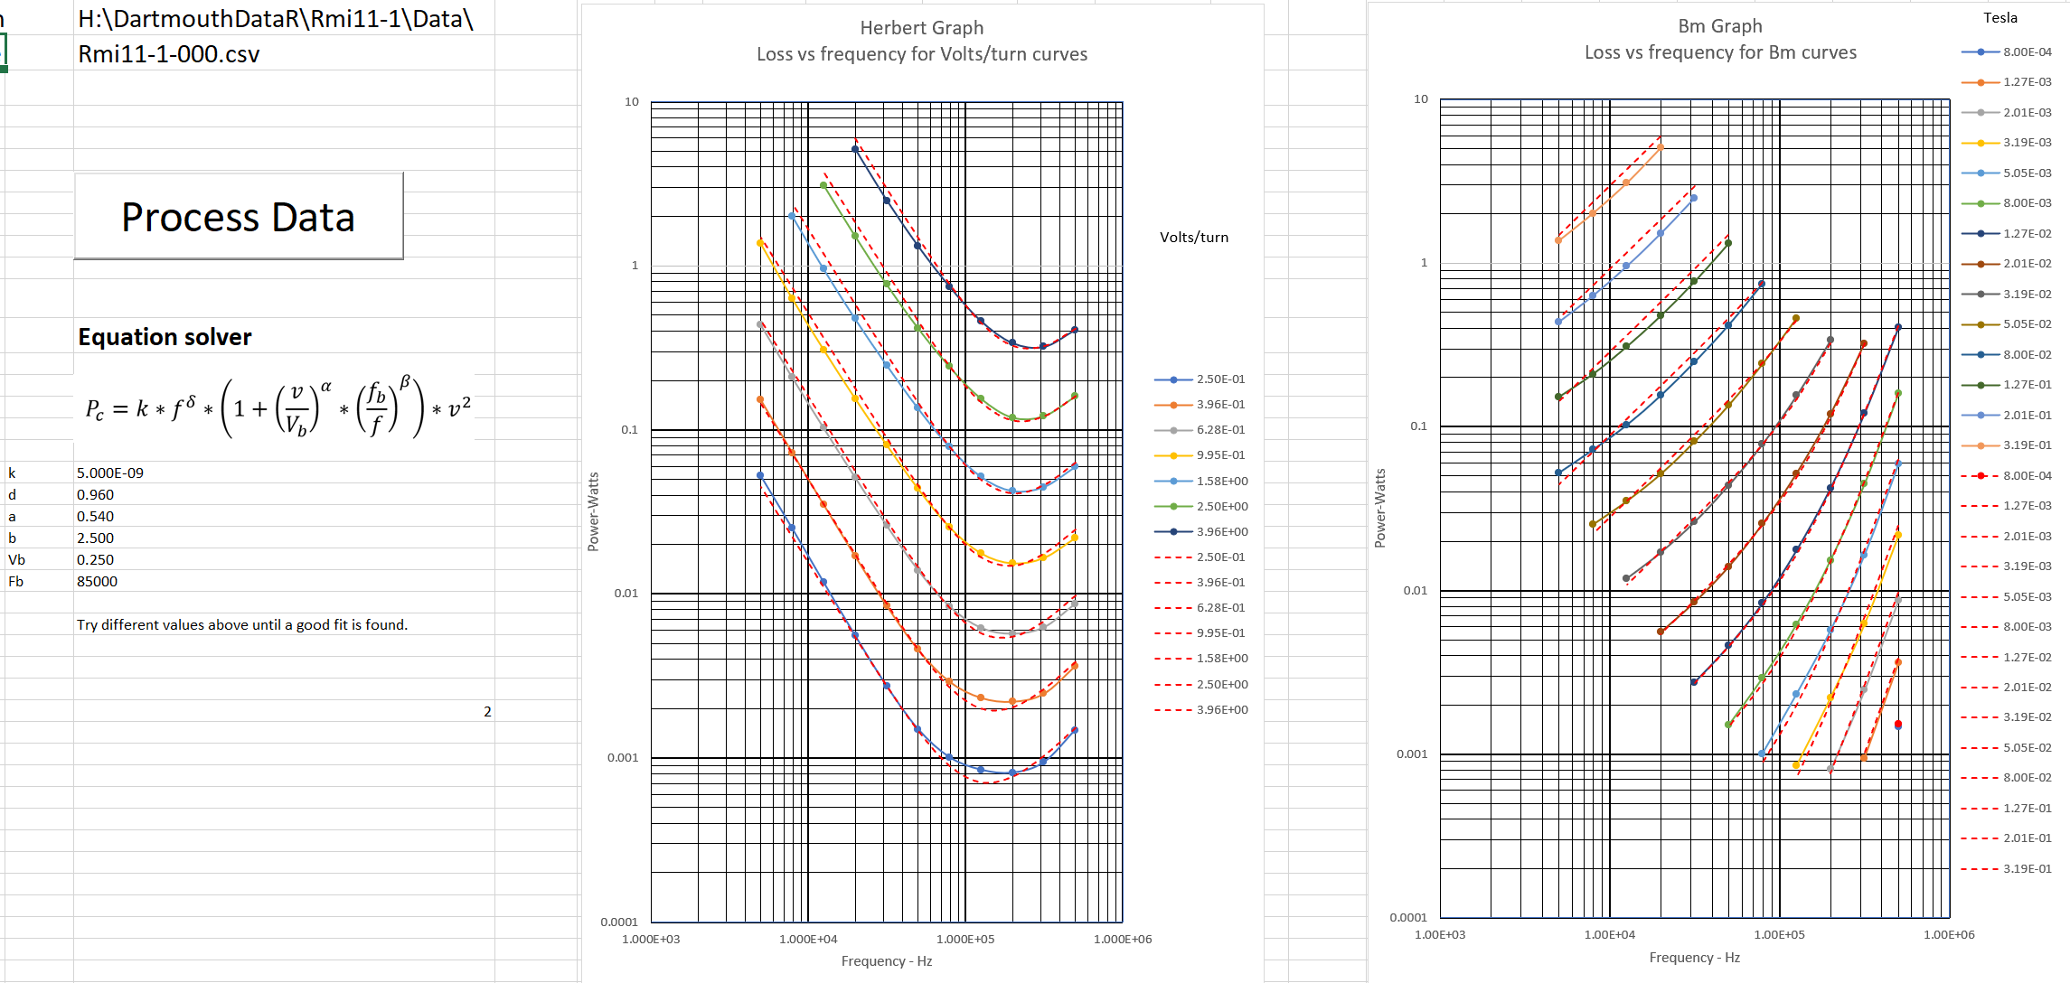

Slide 27
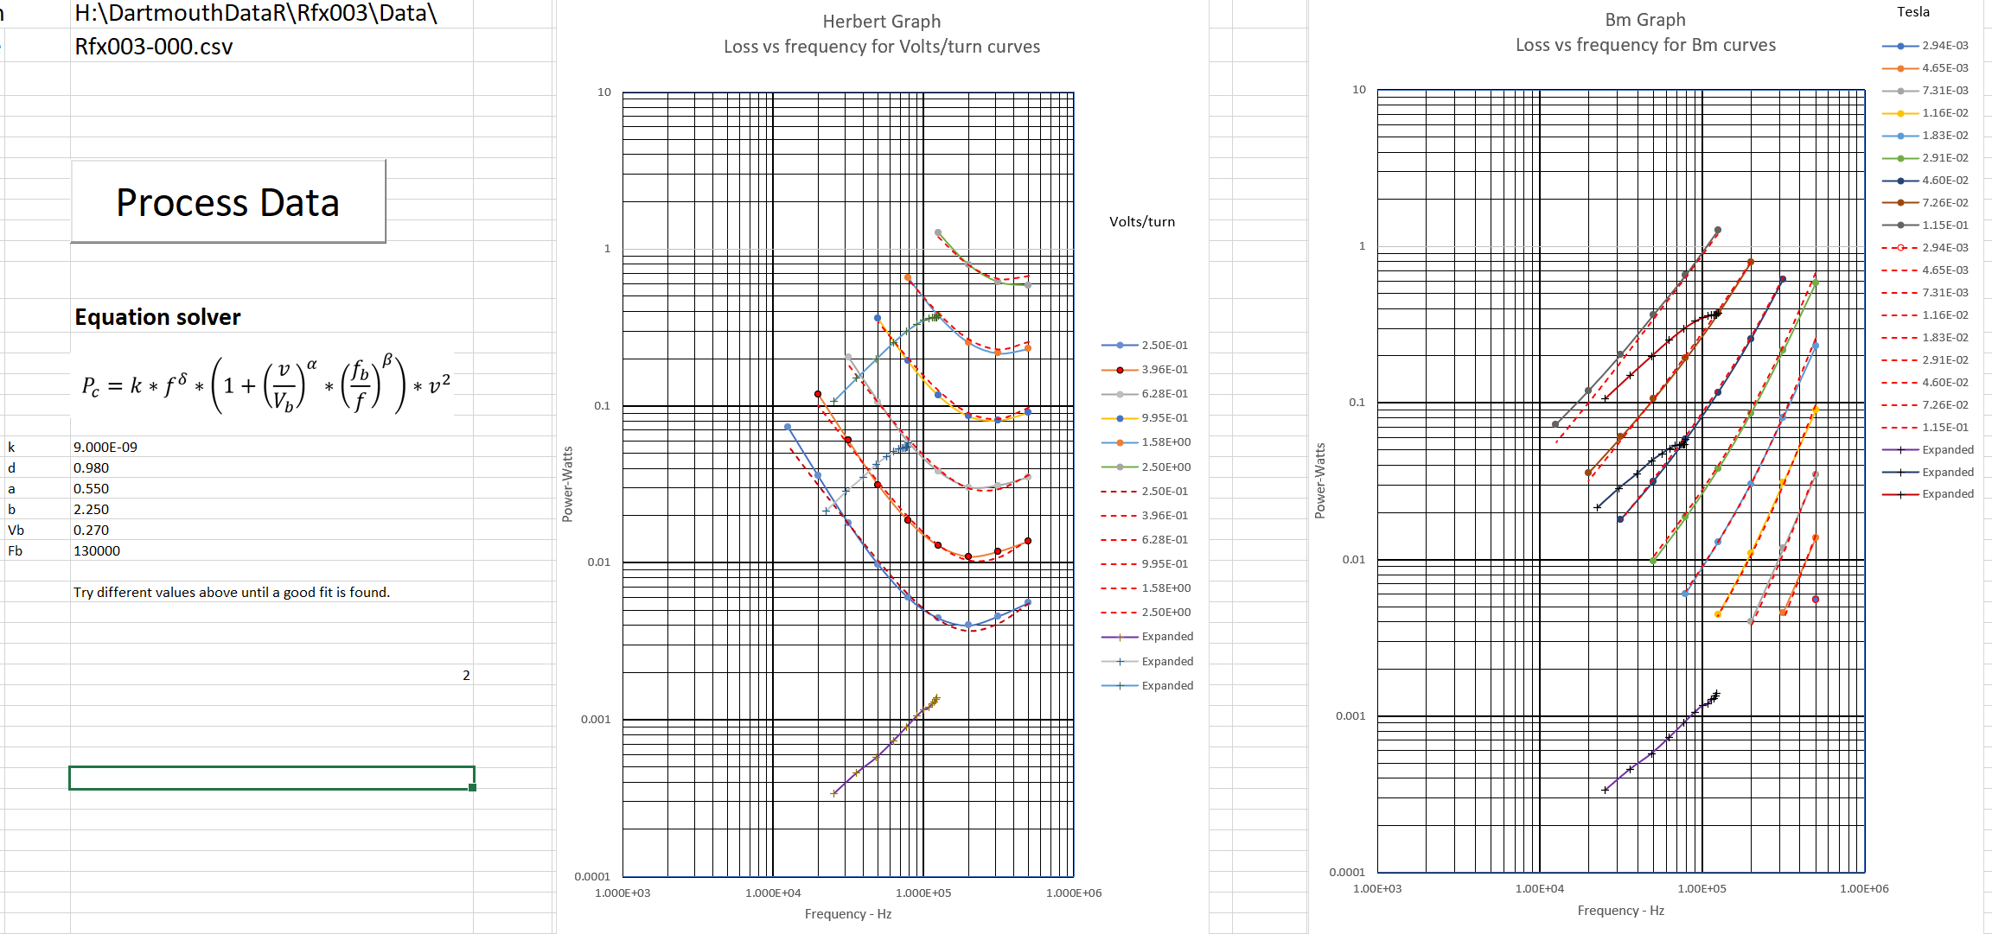

Slide 28
References
Glenn Skutt’s thesis https://vtechworks.lib.vt.edu/handle/10919/30596
E. Herbert workshop presentations on data and SPICE models https://www.psma.com/sites/default/files/uploads/files/Generic%20Specification%20for%20Ferrite%20Cores%20(Ed%20Herbert%2C%20PSMA).pdf https://www.psma.com/sites/default/files/uploads/files/Magnetics%20Workshop%202017/Herbert_Core%20Loss%20Parameters.pdf https://www.psma.com/sites/default/files/uploads/files/Magnetics%20Workshop%202017/Herbert_Core%20Loss%20Modeling.pdf

